Slide 1


Form 12BB Process Document
Global Payroll

Slide 2
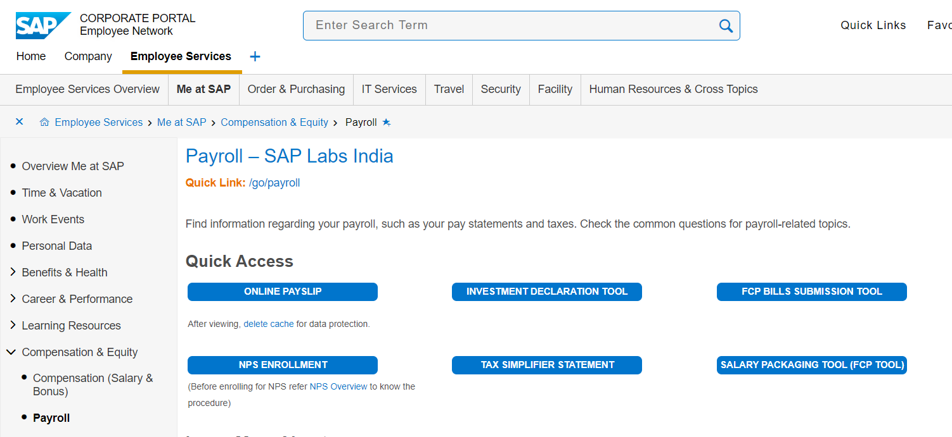
STEP 1 – Landing Page
Click on IT Tool

Slide 3
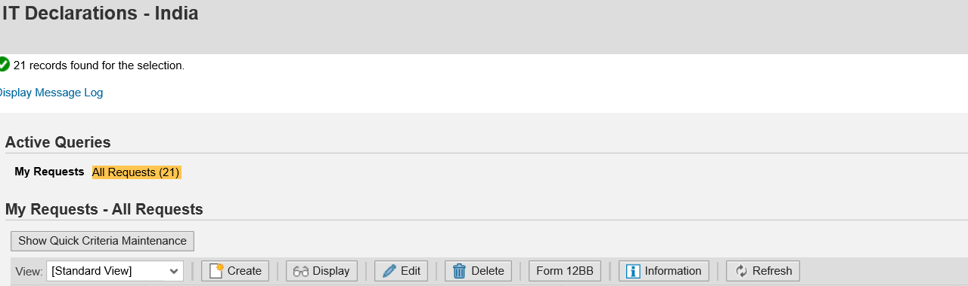
STEP 2 – Click on Form 12 BB
Click on Form 12BB

Slide 4
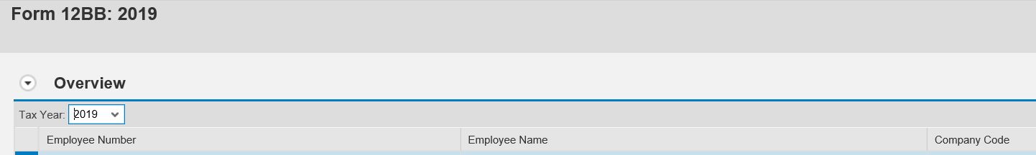
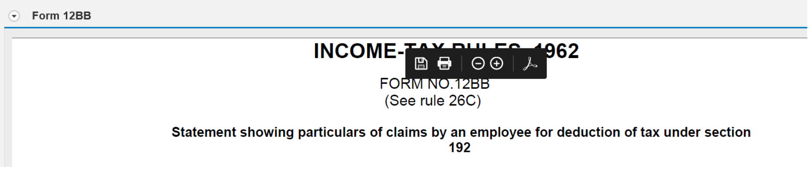
STEP 3 – Select Year and Download Document
Select year 2019
Save it in PDF Format.
In case you are not able see the tool bar, you may also right click and save the document in PDF

Slide 5
STEP 4.1 – Sign 12BB
Print and sign the document.
Upload the signed copy as mention from slide 7.
In case you cannot print the hard copy of the document (Considering the COVID 19 situation) you may use the PDF signature. Please refer next slides to know the process.
Print the document

Slide 6
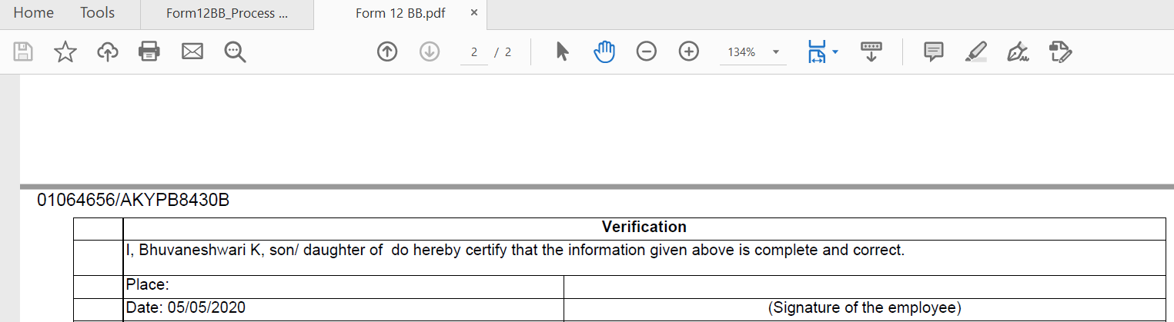
STEP 4.2 – Sign 12BB
(2) Click on PDF Signer
(1) Check details in document and scroll down to the last page

Slide 7
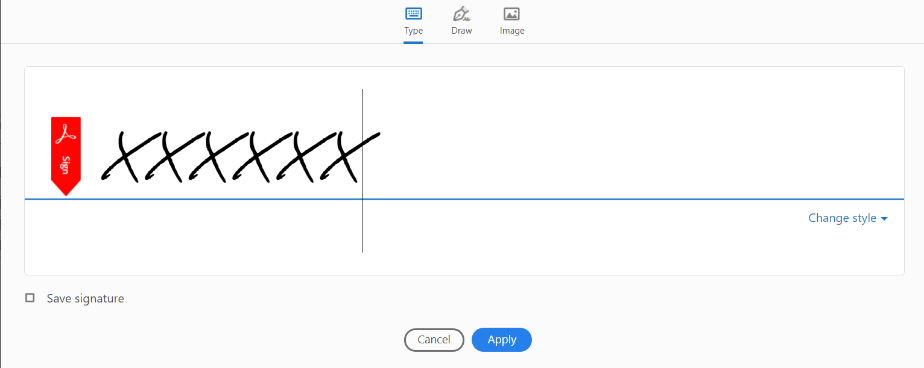
STEP 5 – Select the type of Signature
Select how you want to sign the document (type/draw/Image)
Sign the document
Click on apply

Slide 8
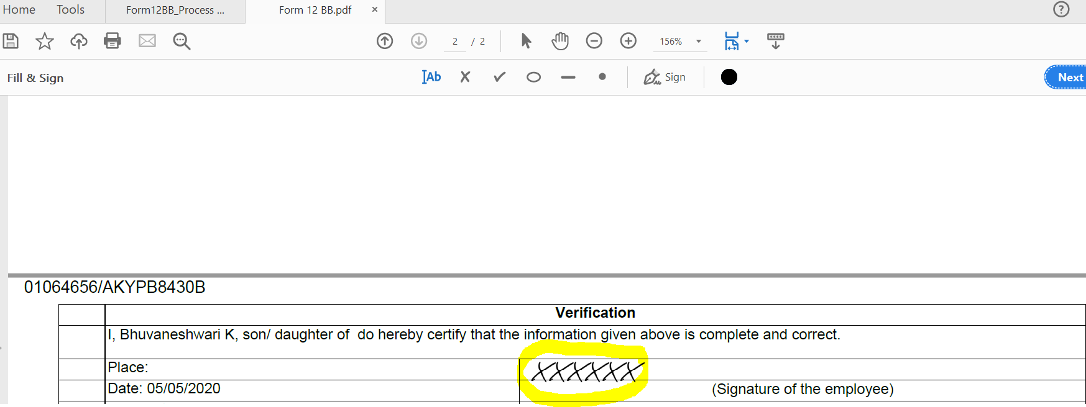
STEP 6 – Sign and Save Document
Save document after applying the signature
Apply Signature at the bottom of document

Slide 9
STEP 7 – Go to First Page again
Click on Create

Slide 10
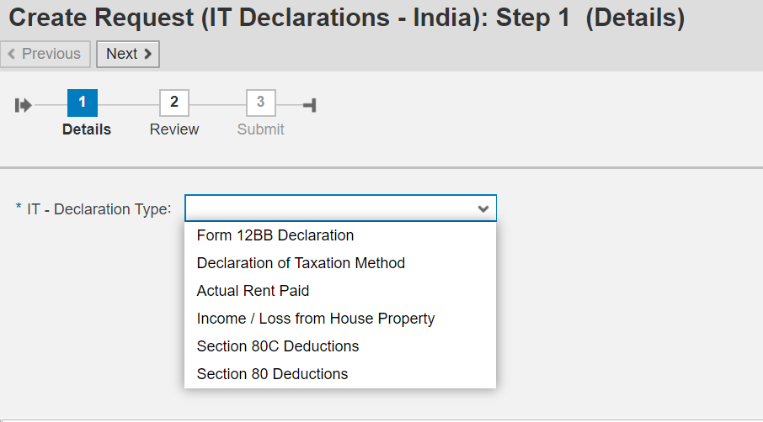
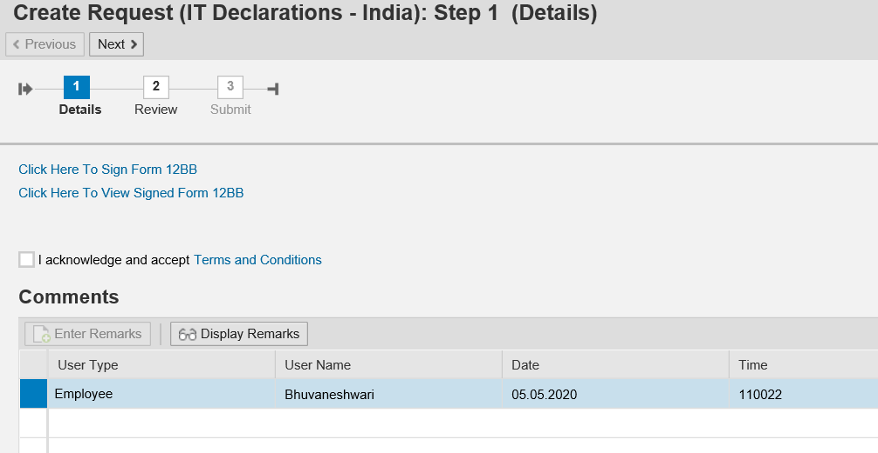
STEP 8– Select Form 12BB
Select Form 12 BB
Tick this check box

Slide 11
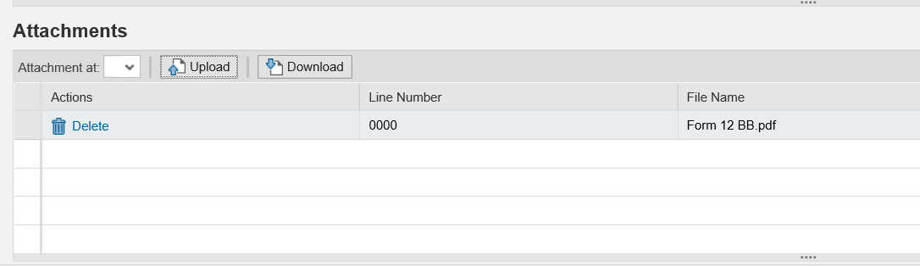
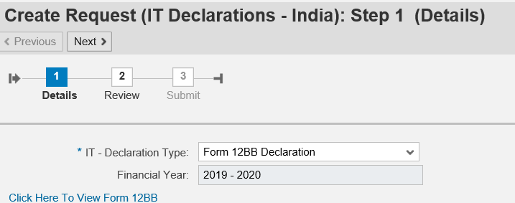
STEP 9- Upload Signed Document
Click and Upload Document
Check if document uploaded
Click on next

Slide 12
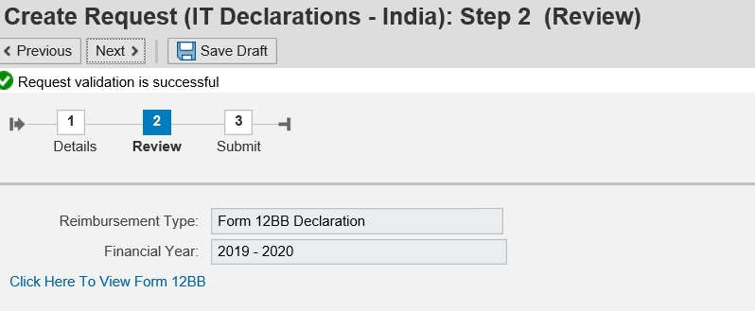
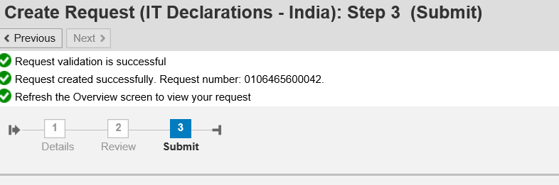
STEP 10 – Submit Document
Again Click on next
Ensure request is submitted successfully

Slide 13
Thank You!

